Slide 1
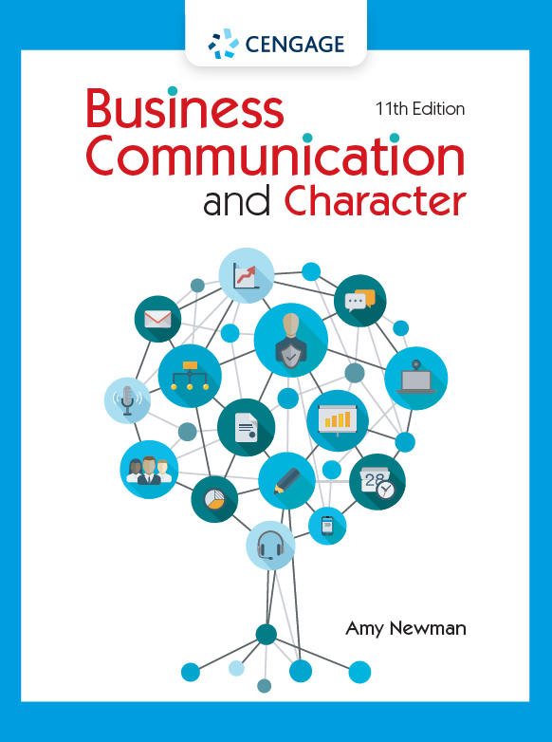
AI as Peer Reviewer
Christy McDowell
Amy Newman
Cornell University
ABC | October 2023

Slide 2
Agenda
Our Goals for AI Peer Reviews
Student Reflections on the Feedback
Student Reflections on the Dangers of Using AI

Slide 3
The Use Case Addressed Three Approaches to AI Assignments
AI USE | ROLE
Mentor | Provide feedback
Tutor | Give direct instruction
Coach | Prompt metacognition
Teammate | Increase team performance
Student | Receive explanations
Simulator | Deliberate practice
Tool | Accomplish tasks
Mollick and Mollick, 2023
Notes:
Note missing “instructor” role – will be relevant

Slide 4
The Use Case Focused on Benefits and Risks
AI USE | ROLE | PEDAGOGICAL BENEFIT | PEDAGOGICAL RISK
Mentor | Provide feedback | Frequent feedback improves learning outcomes, even if all advice is not taken. | Not critically examining feedback, which may contain errors.
Tutor | Give direct instruction | Personalized direct instruction is very effective. | Uneven knowledge base of AI. Serious confabulation risks.
Coach | Prompt metacognition | Opportunities for reflection and regulation improve learning outcomes. | Tone or style of coaching may not match student. Risks of incorrect advice.
Mollick and Mollick, 2023

Slide 5
Our Goals Included Improving Feedback and Using AI
Give students opportunities to practice and improve giving feedback
Provide students with more feedback on their own work
Encourage students to examine feedback critically—from peers and from AI
Inspire student reflection on benefits and risks of using AI tools

Slide 6
Six Assignment Components Inspired Reflection
Step 1: Submit Your Assignment 1 Draft Outline
Step 2: Review Two Students’ Outlines
Step 3: Ask ChatGPT for Feedback
Step 4: Reflect on Your Experience with ChatGPT
Step 5: Compare AI and Human Feedback
Step 6: Reflect on Peer Feedback

Slide 7
Students Reflected on ChatGPT’s Feedback Skills
33
13
6
6
2

Slide 8
Students Compared Activity to Previous Peer Feedback
7

Slide 9
Students Compared Anonymous and In-Class Feedback
Anonymous Peer Feedback
vs.
In-Class Peer Feedback
Critical
Constructive
Honest
Less detailed/surface-level
Personal and emotional
Detailed/in-depth
Idea-driven
Affirming

Slide 10
Students Reflected on Dangers of Using AI

Slide 11
We Revised the Assignment in Two Significant Ways
Sample Prompt
Changed “tutor” to “instructor”
Added audience analysis

Slide 12
Reference
Mollick, Ethan R. and Mollick, Lilach. Assigning AI: Seven Approaches for Students, with Prompts. September 23, 2023. http://dx.doi.org/10.2139/ssrn.4475995.

Slide 13
Thank you!
Christy McDowell clm354@cornell.edu
Amy Newman
amynewman@cornell.edu

